Slide 1
Chapter 6: Securing the Local Area Network
CCNA Security v2.0

Slide 2
Chapter Outline
6.0 Introduction
6.1 Endpoint Security
6.2 Layer 2 Security Threats
6.3 Summary

Slide 3
Section 6.1: Endpoint Security
Upon completion of this section, you should be able to:
Describe endpoint security and the enabling technologies.
Explain how Cisco AMP is used to ensure endpoint security.
Explain how Cisco NAC authenticates and enforces the network security policy.

Slide 4
Topic 6.1.1: Introducing Endpoint Security

Slide 5
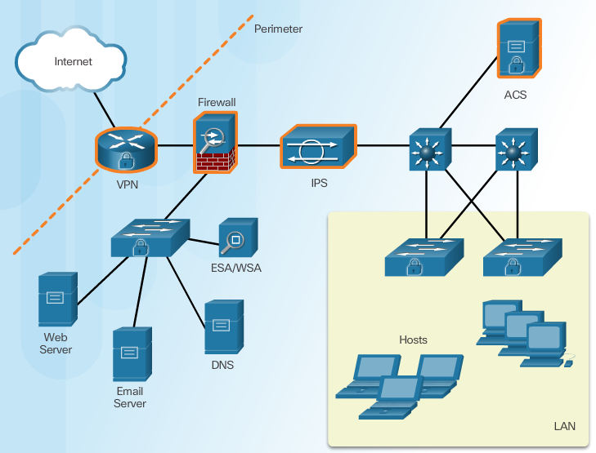
Securing LAN Elements
Notes:
6.1.1.1 Securing LAN Elements

Slide 6
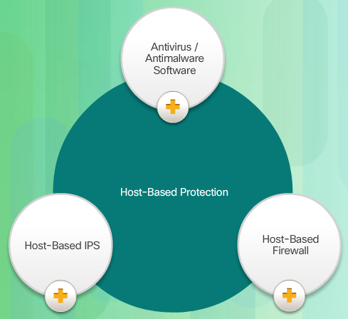
Traditional Endpoint Security
Notes:
6.1.1.2 Traditional Endpoint Security

Slide 7

The Borderless Network
Notes:
6.1.1.3 The Borderless Network

Slide 8
Securing Endpoints in the Borderless Network
Post malware attack questions:
Where did it come from?
What was the threat method and point of entry?
What systems were affected?
What did the threat do?
Can I stop the threat and root cause?
How do we recover from it?
How do we prevent it from happening again?
Host-Based Protection:
Antivirus/Antimalware
SPAM Filtering
URL Filtering
Blacklisting
Data Loss Prevention (DLP)
Notes:
6.1.1.4 Securing Endpoints in the Borderless Network

Slide 9
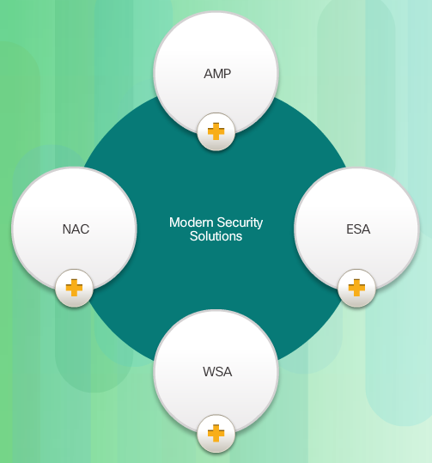
Modern Endpoint Security Solutions
Notes:
6.1.1.5 Modern Endpoint Security Solutions

Slide 10

Hardware and Software Encryption of Local Data
Notes:
6.1.1.6 Hardware and Software Encryption of Local Data
6.1.1.7 Activity – Identify Endpoint Security Terminology (DND)

Slide 11
Topic 6.1.2: Antimalware Protection

Slide 12
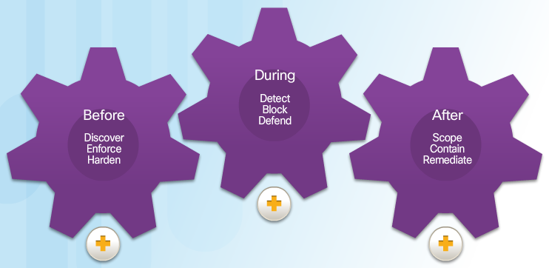
Advanced Malware Protection
Notes:
6.1.2.1 Advanced Malware Protection

Slide 13
AMP and Managed Threat Defense
Talos teams gather real-time threat intelligence from a variety of sources:
1.6 million deployed security devices, including firewall, IPS, web, and email appliances
150 million endpoints
They then analyze this data:
100 TB of security intelligence daily
13 billion web requests per day
35% of the world’s enterprise email traffic
Notes:
6.1.2.2 AMP and Managed Threat Defense

Slide 14
AMP for Endpoints
AMP for Endpoints - AMP for Endpoints integrates with Cisco AMP for Networks to deliver comprehensive protection across extended networks and endpoints.
AMP for Networks - Provides a network-based solution and is integrated into dedicated Cisco ASA Firewall and Cisco FirePOWER network security appliances.
AMP for Content Security – This is an integrated feature in Cisco Cloud Web Security or Cisco Web and Email Security Appliances to protect against email and web-based advanced malware attacks.
Notes:
6.1.2.3 AMP for Endpoints

Slide 15
Topic 6.1.3: Email and Web Security

Slide 16

Securing Email and Web
Notes:
6.1.3.1 Securing Email and Web

Slide 17
Cisco Email Security Appliance
Features and benefits of Cisco Email Security solutions:
Global threat intelligence
Spam blocking
Advanced malware protection
Outbound message control
Notes:
6.1.3.2 Cisco Email Security Appliance

Slide 18
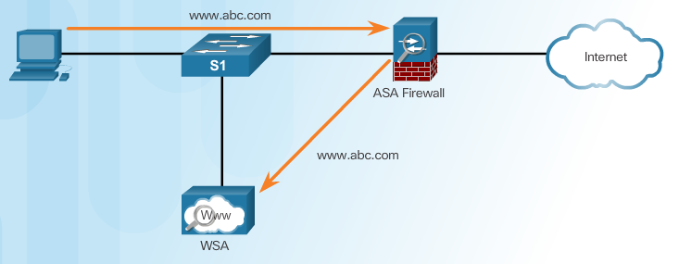
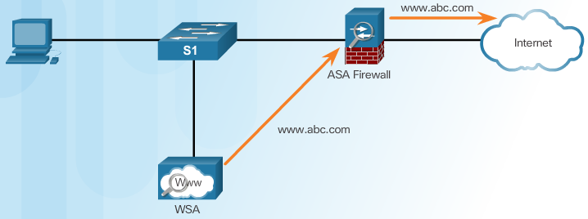
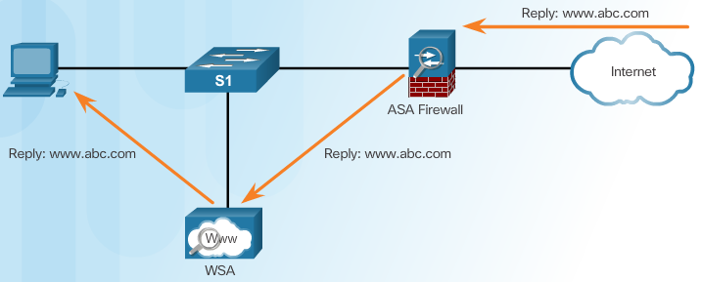
Cisco Web Security Appliance
Client Initiates Web Request
WSA Forwards Request
Reply Sent to WSA and Then To Client
Notes:
6.1.3.3 Cisco Web Security Appliance

Slide 19
Topic 6.1.4: Controlling Network Access

Slide 20
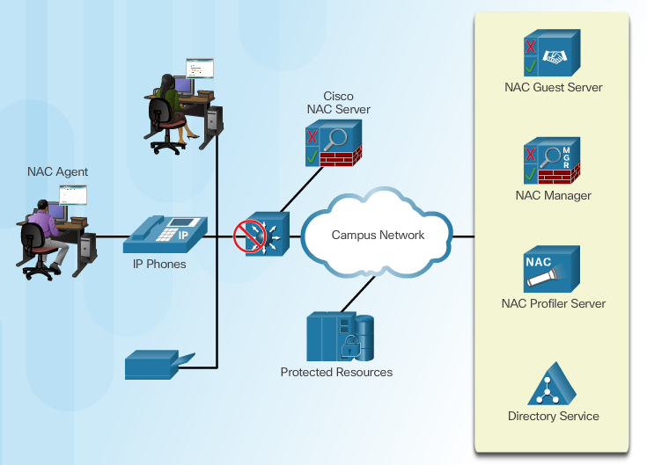
Cisco Network Admission Control
Notes:
6.1.4.1 Cisco Network Admission Control

Slide 21
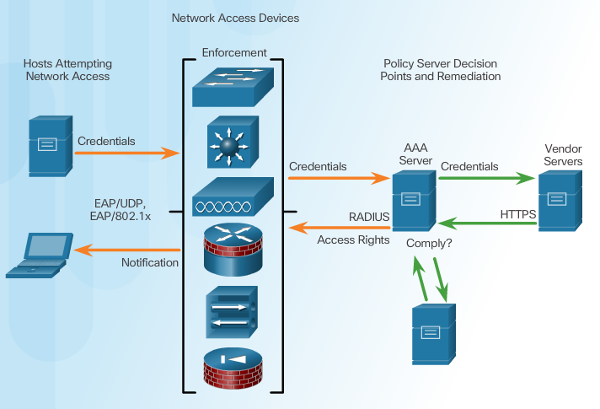
Cisco NAC Functions
Notes:
6.1.4.2 Cisco NAC Functions

Slide 22
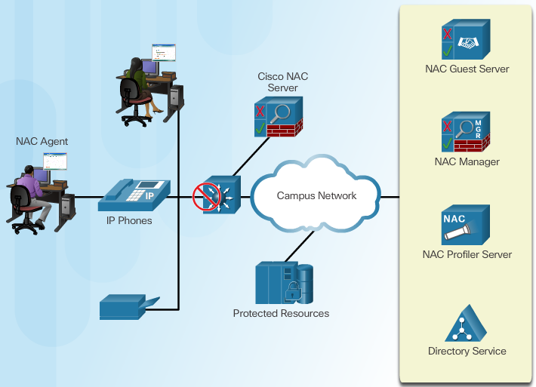
Cisco NAC Components
Notes:
6.1.4.3 Cisco NAC Components

Slide 23
Network Access for Guests
Three ways to grant sponsor permissions:
to only those accounts created by the sponsor
to all accounts
to no accounts (i.e., they cannot change any permissions)
Notes:
6.1.4.4 Network Access for Guests

Slide 24
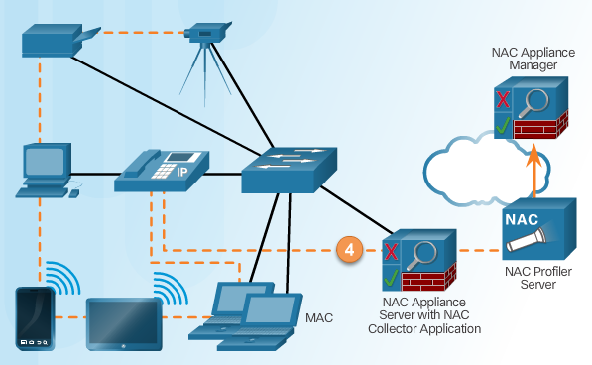
Cisco NAC Profiler
Notes:
6.1.4.5 Cisco NAC Profiler

Slide 25
Section 6.2: Layer 2 Security Considerations
Upon completion of the section, you should be able to:
Describe Layer 2 vulnerabilities.
Describe CAM table overflow attacks.
Configure port security to mitigate CAM table overflow attacks.
Configure VLAN Truck security to mitigate VLAN hopping attacks.
Implement DHCP Snooping to mitigate DHCP attacks.
Implement Dynamic Arp Inspection to mitigate ARP attacks.
Implement IP Source Guard to mitigate address spoofing attacks.

Slide 26
Topic 6.2.1: Layer 2 Security Threats

Slide 27
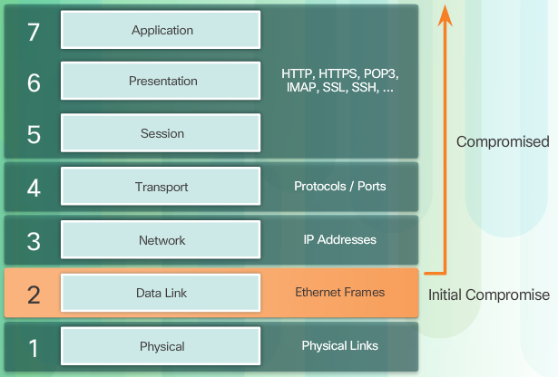
Describe Layer 2 Vulnerabilities
Notes:
6.2.1.1 Describe Layer 2 Vulnerabilities

Slide 28
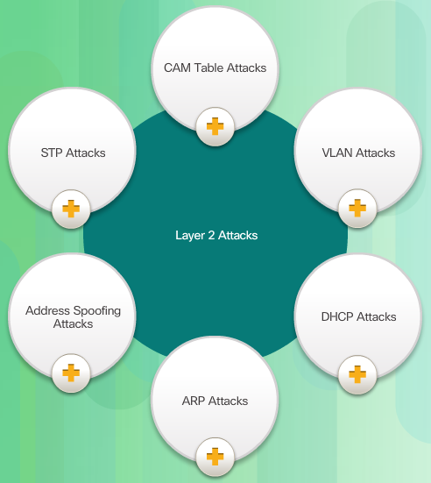
Switch Attack Categories
Notes:
6.2.1.2 Switch Attack Categories

Slide 29
Topic 6.2.2: CAM Table Attacks

Slide 30
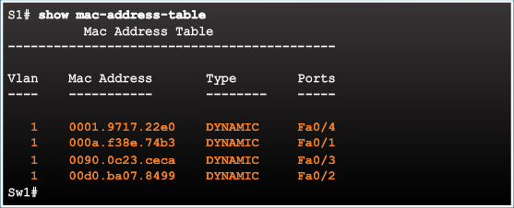
Basic Switch Operation
Notes:
6.2.2.1 Basic Switch Operation

Slide 31
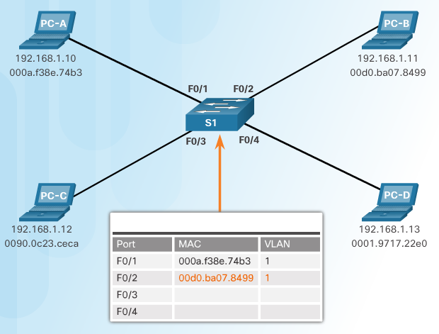
CAM Table Operation Example
Notes:
6.2.2.2 CAM Table Operation Example

Slide 32
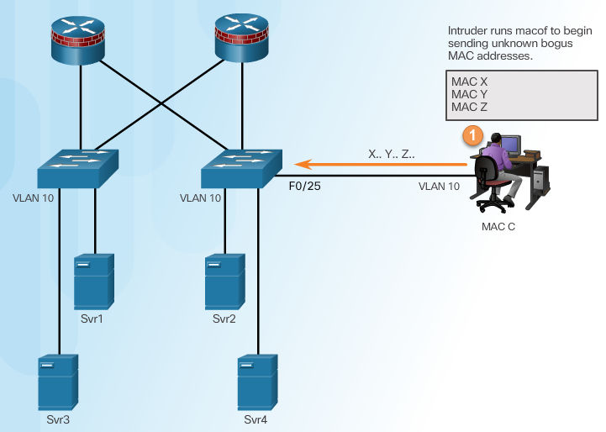
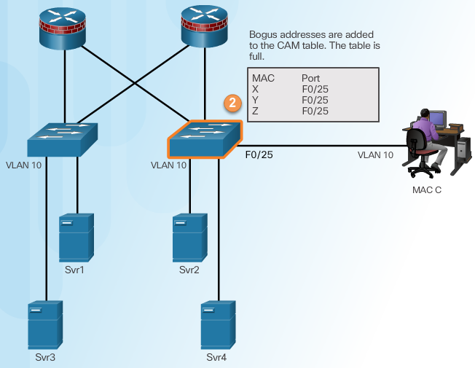
CAM Table Attack
Intruder Runs Attack Tool
Fill CAM Table
Notes:
6.2.2.3 CAM Table Attack

Slide 33
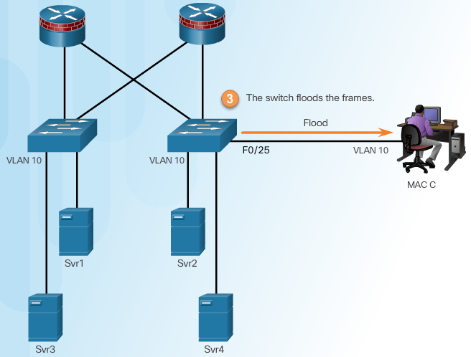
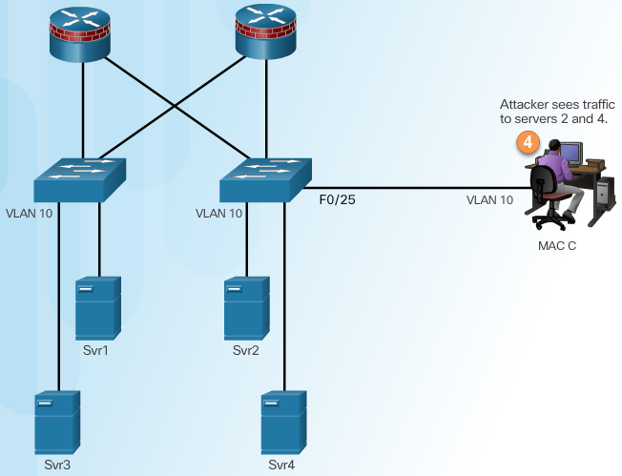
CAM Table Attack
Switch Floods All Traffic
Attacker Captures Traffic
Notes:
6.2.2.3 CAM Table Attack (Cont.)

Slide 34
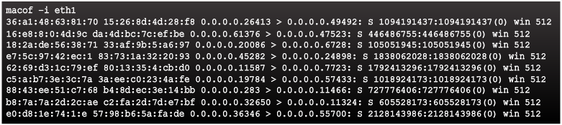
CAM Table Attack Tools
Notes:
6.2.2.4 CAM Attack Tools

Slide 35
Topic 6.2.3: Mitigating CAM Table Attacks

Slide 36
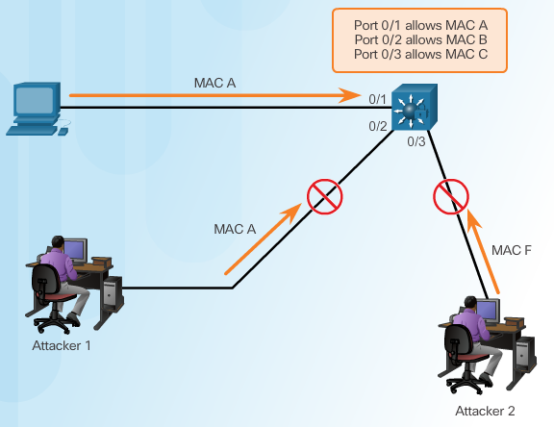
Countermeasure for CAM Table Attacks
Notes:
6.2.3.1 Countermeasure for CAM Table Attacks

Slide 37
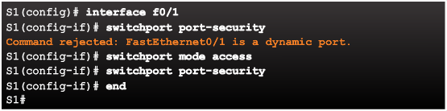
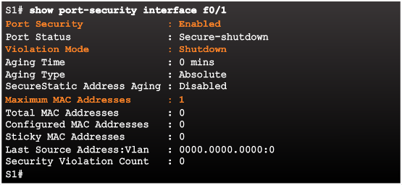
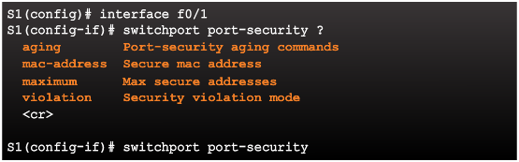
Port Security
Enabling Port Security
Verifying Port Security
Port Security Options
Notes:
6.2.3.2 Port Security

Slide 38
Enabling Port Security Options
Setting the Maximum Number of Mac Addresses
Manually Configuring Mac Addresses
Learning Connected Mac Addresses Dynamically
Notes:
6.2.3.3 Enabling Port Security Options

Slide 39
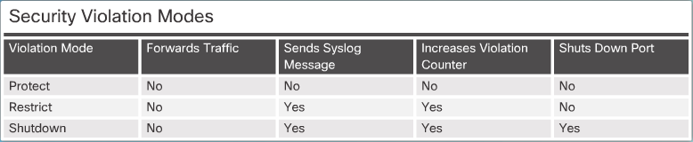
Port Security Violations
Security Violation Modes:
Protect
Restrict
Shutdown
Notes:
6.2.3.4 Port Security Violations

Slide 40
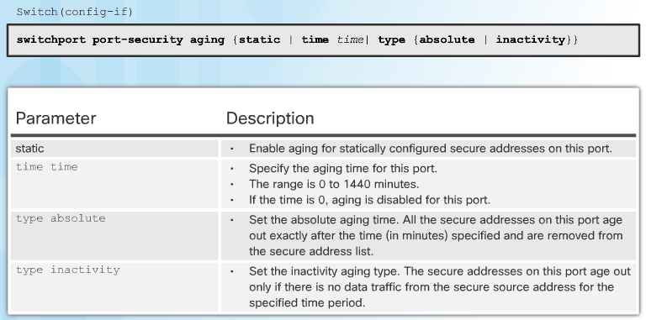
Port Security Aging
Notes:
6.2.3.5 Port Security Aging

Slide 41

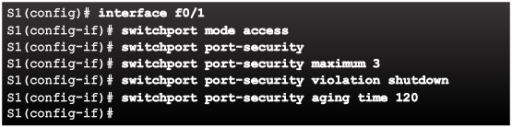
Port Security with IP Phones
Notes:
6.2.3.6 Port Security with IP Phones

Slide 42
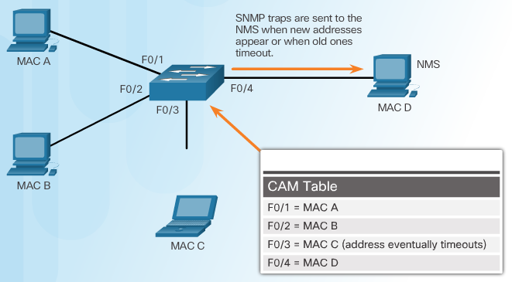
SNMP MAC Address Notification
Notes:
6.2.3.7 SNMP MAC Address Notification

Slide 43
Topic 6.2.4: Mitigating VLAN Attacks

Slide 44
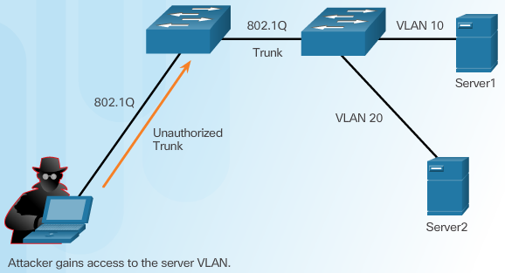
VLAN Hopping Attacks
Notes:
6.2.4.1 VLAN Hopping Attacks

Slide 45
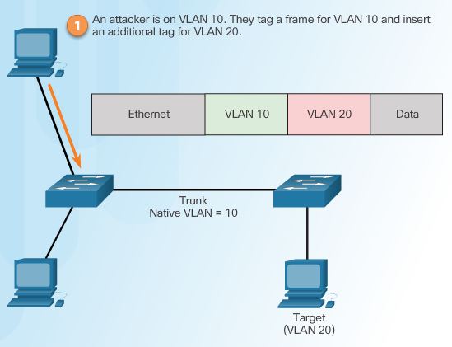
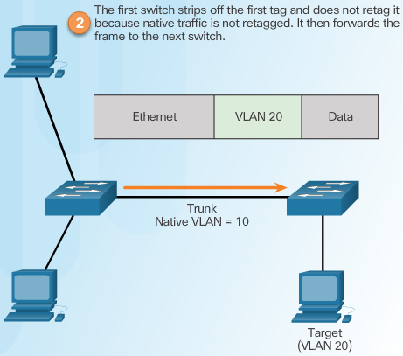
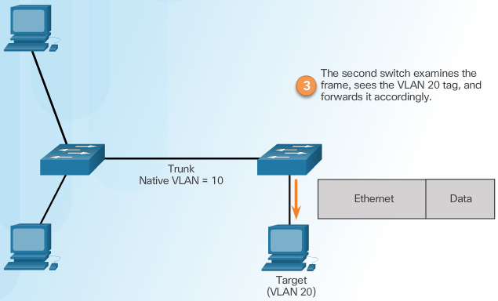
VLAN Double-Tagging Attack
Step 1 – Double Tagging Attack
Step 2 – Double Tagging Attack
Step 3 – Double Tagging Attack
Notes:
6.2.4.2 VLAN Double-Tagging Attack

Slide 46
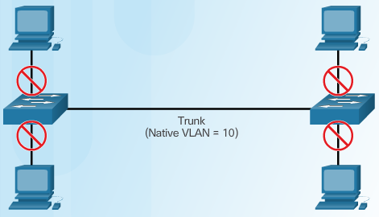
Mitigating VLAN Hopping Attacks
Notes:
6.2.4.3

Slide 47
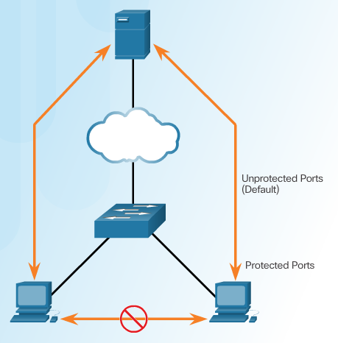
PVLAN Edge Feature
Notes:
6.2.4.4 PVLAN Edge Feature

Slide 48
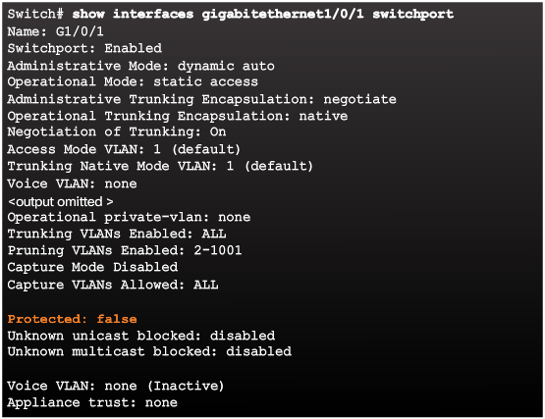
Verifying Protected Ports
Notes:
6.2.4.5 Verifying Protected Ports

Slide 49
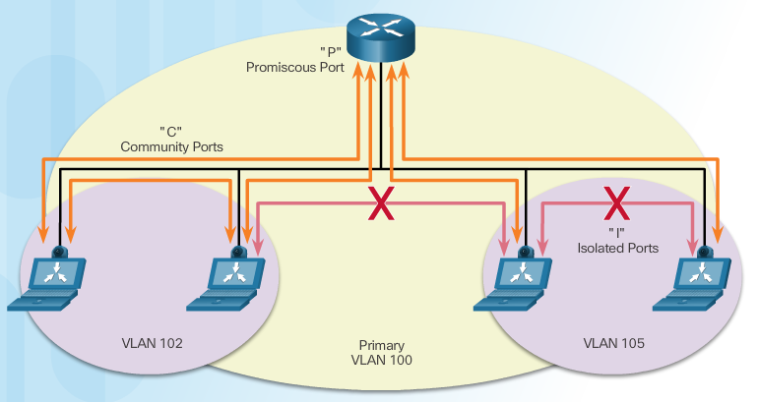
Private VLANs
Notes:
6.2.4.6 Private VLANs
6.2.4.7 Video Demonstration – Private VLAN tutorial and demonstration

Slide 50
Topic 6.2.5: Mitigating DHCP Attacks

Slide 51
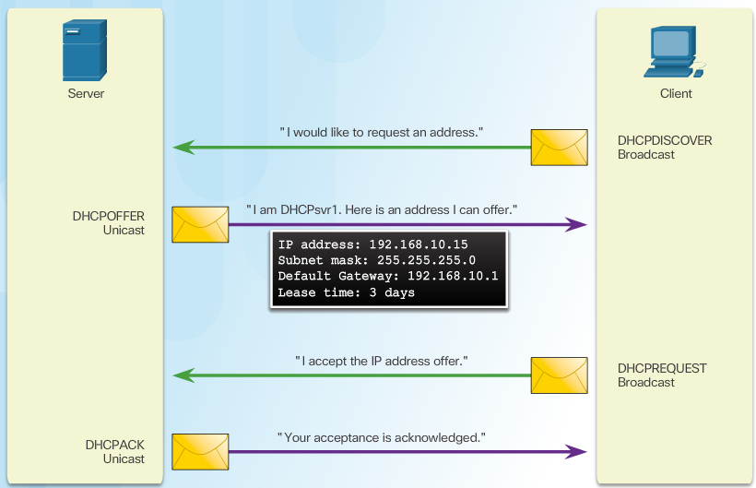
DHCP Spoofing Attack
Notes:
6.2.5.1 DHCP Spoofing Attack

Slide 52
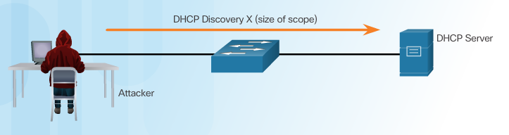
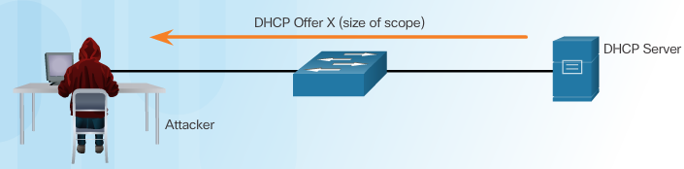
DHCP Starvation Attack
Attacker Initiates a Starvation Attack
DHCP Server Offers Parameters
Notes:
6.2.5.2 DHCP Starvation Attack

Slide 53
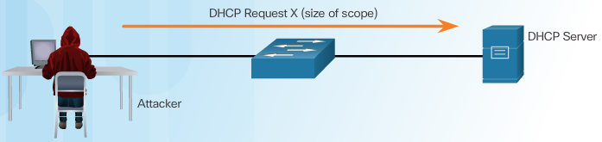
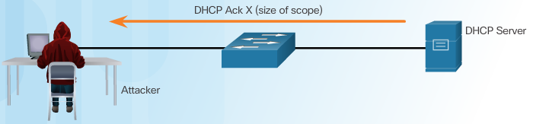
DHCP Starvation Attack
Client Requests all Offers
DHCP Server Acknowledges All Requests
Notes:
6.2.5.2 DHCP Starvation Attack (Cont.)

Slide 54
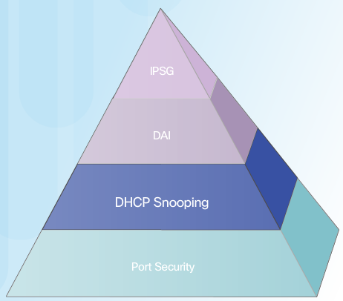
Mitigating VLAN Attacks
The switch will deny packets containing specific information:
Unauthorized DHCP server messages from an untrusted port
Unauthorized DHCP client messages not adhering to the snooping binding table or rate limits
DHCP relay-agent packets that include option-82 information on an untrusted port
Notes:
1.2.3.3 Trojan Horses
1.2.3.4 Trojan Horse Classification

Slide 55
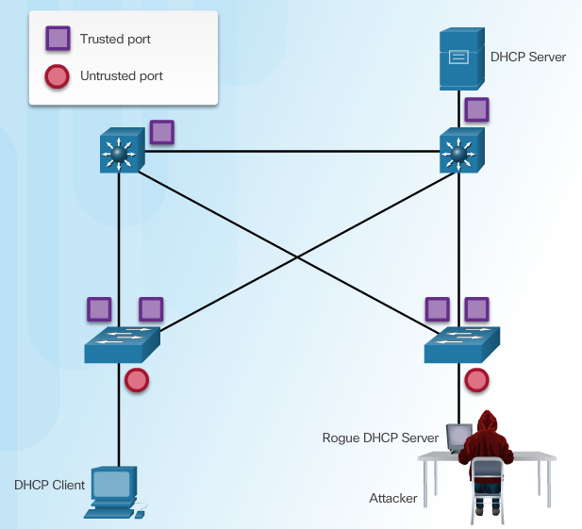
Configuring DHCP Snooping
Notes:
6.2.5.4 Configuring DHCP Snooping
6.2.5.5 Configuring DHCP Snooping Example

Slide 56
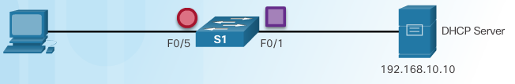
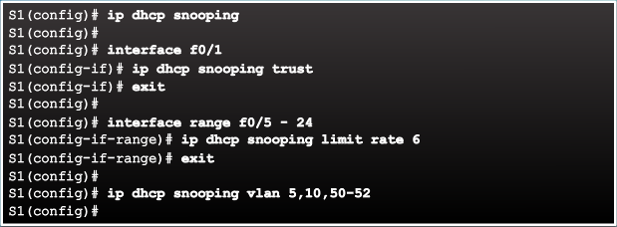
Configuring DHCP Snooping Example
DHCP Snooping Reference Topology
Configuring a Maximum Number of MAC Addresses
Notes:
6.2.5.5 Configuring DHCP Snooping Example

Slide 57
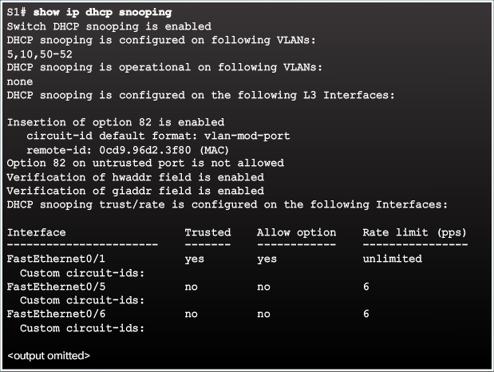
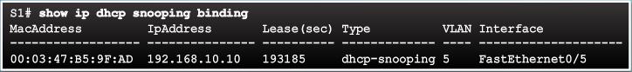
Configuring DHCP Snooping Example
Verifying DHCP Snooping
Configuring a Maximum Number of MAC Addresses
Notes:
6.2.5.5 Configuring DHCP Snooping Example (Cont.)

Slide 58
Topic 6.2.6: Mitigating ARP Attacks

Slide 59
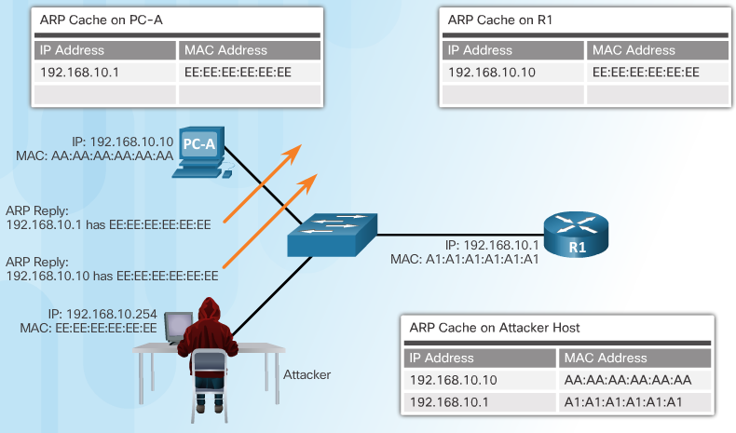
ARP Spoofing and ARP Poisoning Attack
Notes:
6.2.6.1 ARP Spoofing and ARP Poisoning Attack

Slide 60
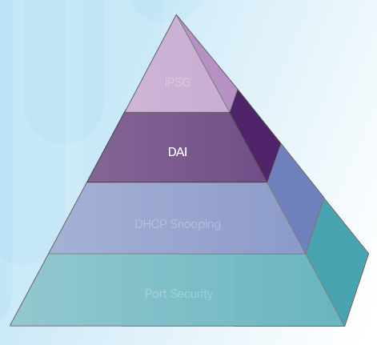
Mitigating ARP Attacks
Dynamic ARP Inspection:
Notes:
6.2.6.2 Mitigating ARP Attacks

Slide 61
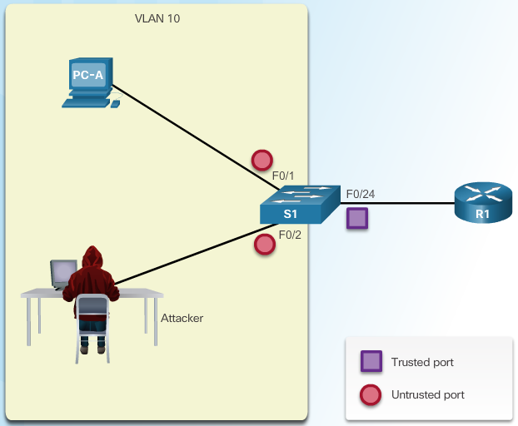
Configuring Dynamic ARP Inspection
Notes:
6.2.6.4 Configuring Dynamic ARP Inspection
6.2.6.5 Configuring Dynamic ARP Inspection Example

Slide 62


Configuring DHCP Snooping Example
ARP Reference Topology
Configuring Dynamic ARP Inspection
Notes:
6.2.6.4 Configuring Dynamic ARP Inspection Example

Slide 63

Configuring DHCP Snooping Example
Checking Source, Destination, and IP
Notes:
6.2.6.4 Configuring Dynamic ARP Inspection Example (Cont.)

Slide 64
Topic 6.2.7: Mitigating Address Spoofing Attacks

Slide 65


Address Spoofing Attack
Notes:
6.2.7.1 Address Spoofing Attack

Slide 66

Mitigating Address Spoofing Attacks
For each untrusted port, there are two possible levels of IP traffic security filtering:
Source IP address filter
Source IP and MAC address filter
Notes:
6.2.7.2 Mitigating Address Spoofing Attacks

Slide 67



Configuring IP Source Guard
IP Source Guard Reference Topology
Configuring IP Source Guard
Checking IP Source Guard
Notes:
6.2.7.3 Configuring IP Source Guard

Slide 68
Topic 6.2.8: Spanning Tree Protocol

Slide 69

Introduction to the Spanning Tree Protocol
Notes:
6.2.8.1 Introduction to the Spanning Tree Protocol

Slide 70

Various Implementations of STP
Notes:
6.2.8.2 Various Implementations of STP

Slide 71

STP Port Roles
Notes:
6.2.8.3 STP Port Roles

Slide 72

STP Root Bridge
Notes:
6.2.8.4 STP Root Bridge

Slide 73

STP Path Cost
Notes:
6.2.8.5 STP Path Cost

Slide 74

802.1D BPDU Frame Format
Notes:
6.2.8.6 802.1D BPDU Frame Format

Slide 75

BPDU Propagation and Process
Notes:
6.2.8.7 BPDU Propagation and Process

Slide 76

Extended System ID
Notes:
6.2.8.8 Extended System ID

Slide 77

Select the Root Bridge
Notes:
6.2.8.9 Select the Root Bridge
6.2.8.10 Activity – Identify the 802.1D RSTP Port Roles
6.2.8.11 Activity – Troubleshoot STP Configuration Issues
6.2.8.12 Video Demonstration – Observing Spanning Tree Protocol Operation

Slide 78
Topic 6.2.9: Mitigating STP Attacks

Slide 79


STP Manipulation Attacks
Spoofing the Root Bridge
Successful STP Manipulation Attack
Notes:
6.2.9.1 STP Manipulation Attacks

Slide 80

Mitigating STP Attacks
Notes:
6.2.9.2 Mitigating STP Attacks

Slide 81

Configuring PortFast
Notes:
6.2.9.3 Configuring PortFast

Slide 82

Configuring BDPU Guard
Notes:
6.2.9.4 Configuring BPDU Guard

Slide 83

Configuring Root Guard
Notes:
6.2.9.5

Slide 84

Configuring Loop Guard
Notes:
6.2.9.5 Configuring Loop Guard

Slide 85
Section 6.3: Summary
Chapter Objectives:
Explain endpoint security.
Describe various types of endpoint security applications.
Describe Layer 2 vulnerabilities.
Notes:
6.3.1.1 Packet Tracer – Layer 2 Security
6.3.1.2 Packet Tracer – Layer 2 VLAN Security
6.3.1.3 Lab – Securing Layer 2 Switches
6.3.1.4 Summary

Slide 87


Instructor Resources
Remember, there are helpful tutorials and user guides available via your NetSpace home page. (https://www.netacad.com)
These resources cover a variety of topics including navigation, assessments, and assignments.
A screenshot has been provided here highlighting the tutorials related to activating exams, managing assessments, and creating quizzes.
1
2
Notes:
https://www.netacad.com

